Slide 1



Interim Report
Development of a Proof of Concept based on SAEON/ DST Shared Platform
G360.4.1 Interim Report
Wim Hugo

Slide 2
Interim Report
Walkthrough – Site Progress
Current Tasks
Project Milestones and Status

Slide 3
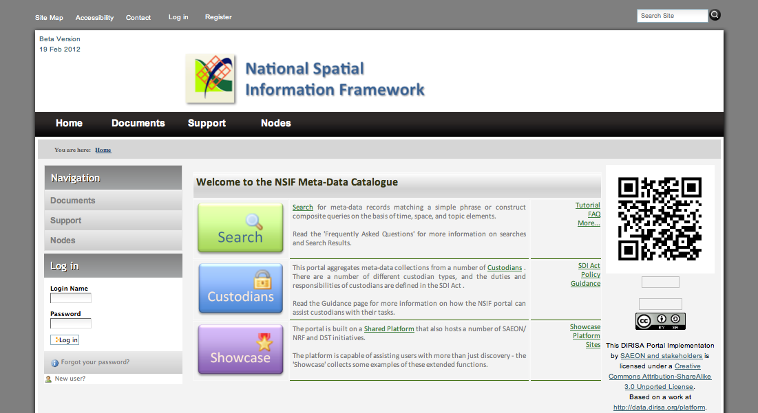
Landing Page
The emphasis is on finding value quickly – hence the search facility is prominent and one click away. Less important topics can be added to the page – users usually don’t mind scrolling down. The menu system, side navigation, and footer section can also be used to provide links to features and functions.

Slide 4
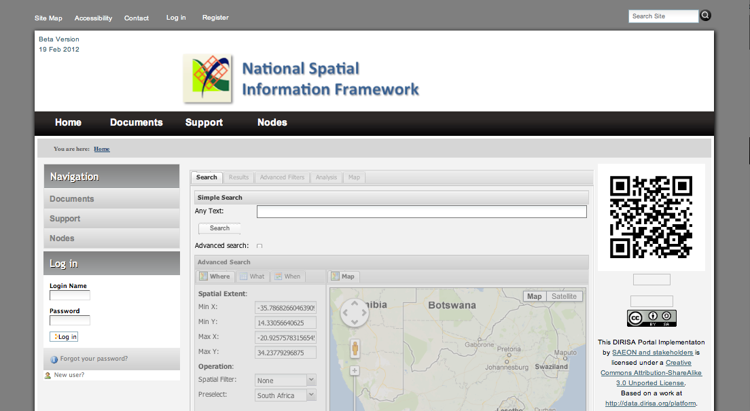
Search by Phrase/ Keyword
Keyword searches are immediately available. Clicking a tick box opens up an advanced search feature.

Slide 5
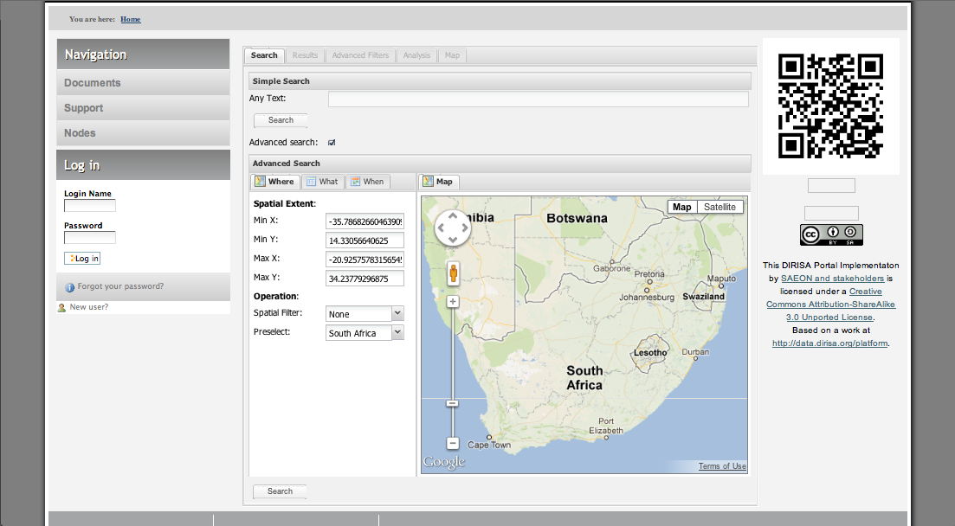
Advanced Search
Advanced Search offers any combination of temporal, spatial, and topic coverages – with spatial extents capable of being preset, and the type of spatial interaction (overlap, inclusion, …) available as well. Composite searches can be saved by advanced users for future re-use.

Slide 6
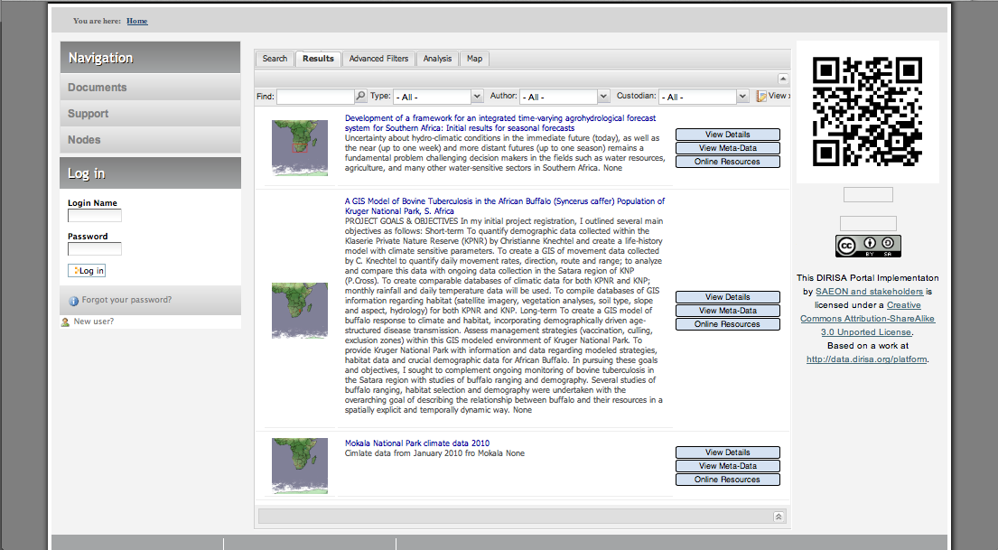
Search Results
Summary meta-data results are listed. These can be expanded to view detail, links back to original meta-data are provided, and online resources referenced in the meta-data can be accessed. In cases where the online resources are standardised services (such as Web Map Services), the services can also be utilised for viewing and downloads of data.

Slide 7
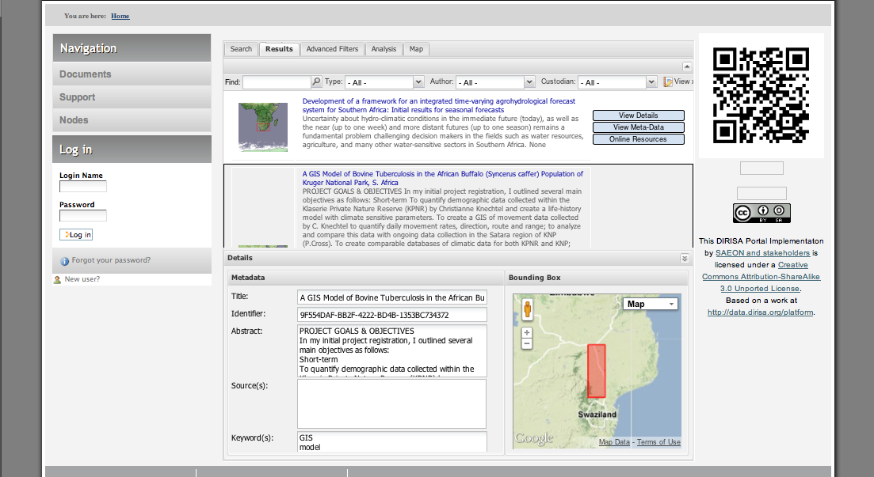
Detail Meta-Data
This is an expanded meta-data view – users can gain a quick overview of the important elements.

Slide 8
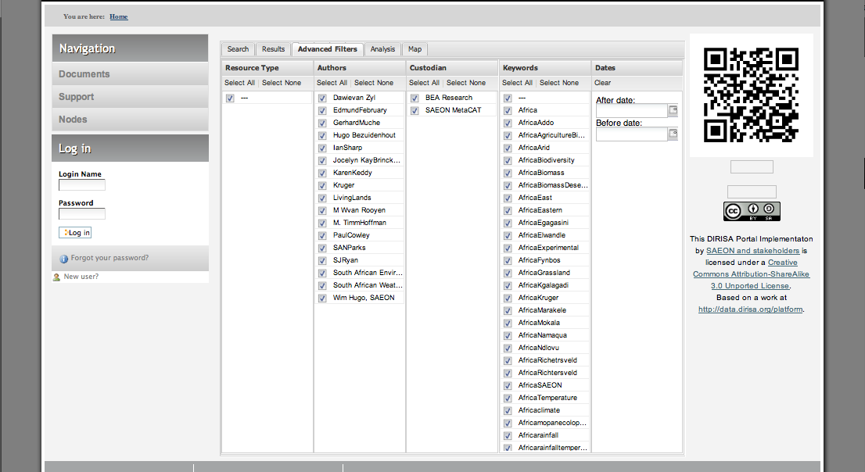
Additional FIltering
Users may want to filter their initial result further – this can be done on the basis of a date range, one or more custodians, keywords, or authors.

Slide 9
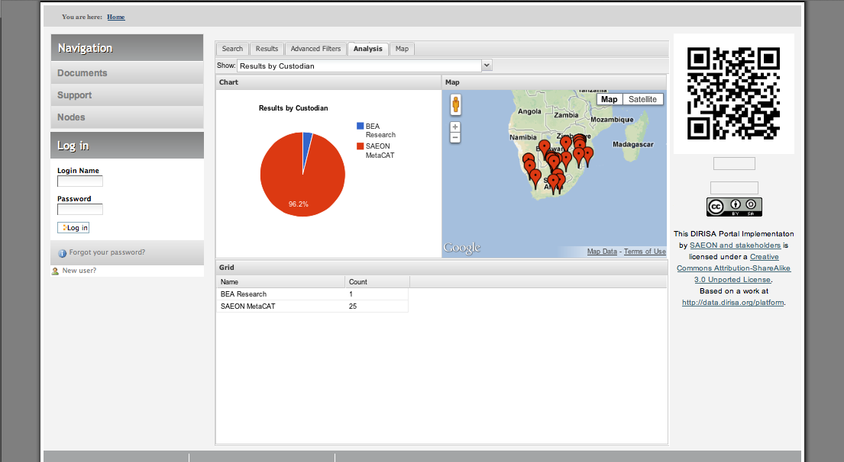
Search Result Analysis
Search Results can also be view in summary, to understand the scope and spatial coverage of the search result better.

Slide 10
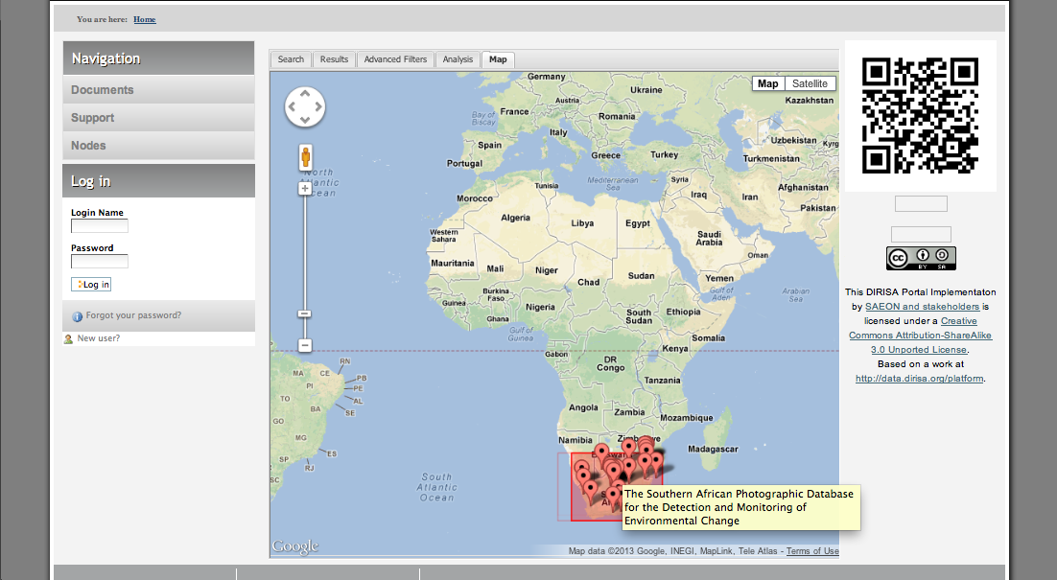
Detailed Search Result Extent
A detailed view of spatial extent of search results is available.

Slide 11
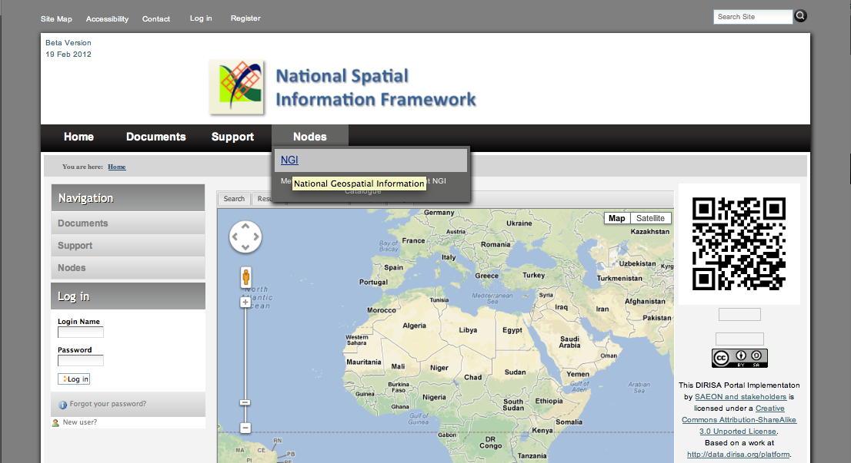
Custodians
Each Custodian (‘Node’) can be accessed directly from the menu system. We have received, and have started processing NGI meta-data for the proof of concept.

Slide 12
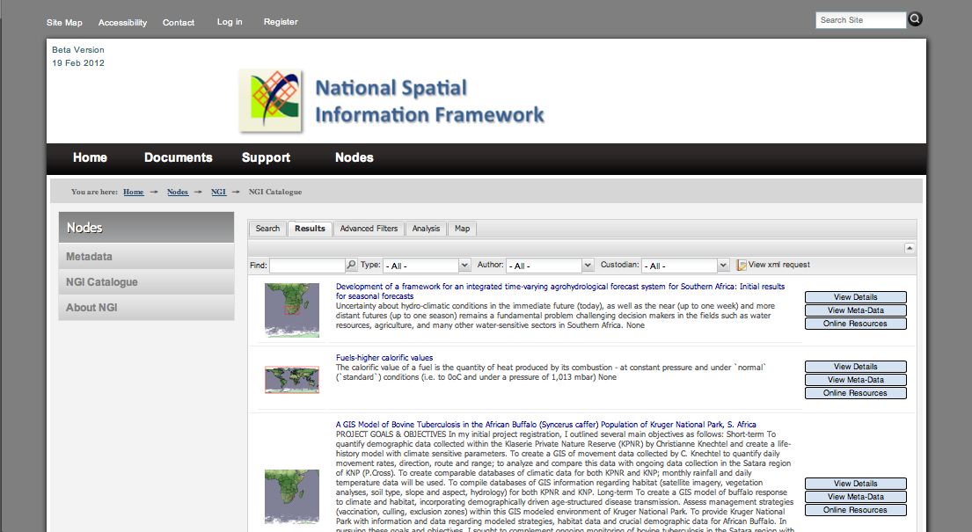
Custodian Catalogue
A catalogue (subset of an aggregated catalogue) is available for each custodian. (This is in practice a ‘Saved Search’ for that custodian). This provides rapid access to the meta-data supplied by a custodian. Options for maintenance range from manual meta-data creation to automated harvesting through standardised protocols (CS/W, OAI-PMH, FTP)

Slide 13
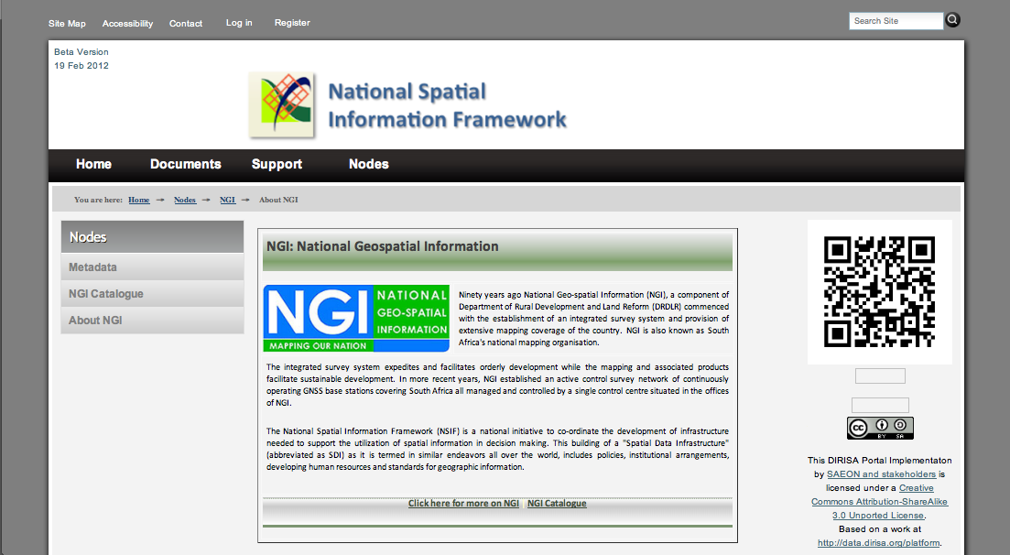
Custodian Information
Custodians can, and should, manage their own presence in the portal. As a minimum we propose a link page – these can be hosted externally and maintained on custodian infrastructure.

Slide 14
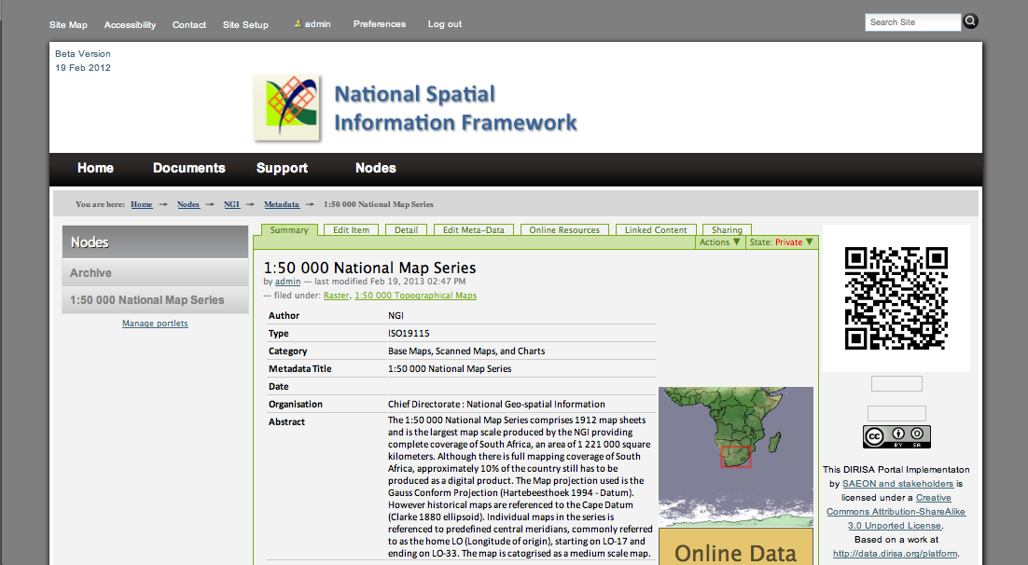
Meta-Data Record
This is an example of an ISO 19115 meta-data record obtained from NGI (1:50,000 Topo Map Series). The portal currently supports ISO 19115 and ISO 19115p2, FGDC, and SANS 1878, amongst others. Meta-data is validated against the formal schema before being published.

Slide 15
Current Tasks
Process and evaluate NGI meta-data
Transfer usable content from SMD
Obtain static page inputs from NSIF
Write acceptance tests based on URS

Slide 16
Project Milestones and Status
Completion of Contracting: End January 2013.
Steering committee and issue resolution mechanisms in place: End January 2013.
Engagement with NGI to plan piloting of custodian implementation: End January 2013.
Deployment of alpha release of the site on SAEON/ CHPC infrastructure: End January 2013.
Access to existing SMD and NSIF content/ documentation: End January 2013.
Agreement on User Acceptance Test Schedules: Mid February 2013.
DRDLR completes static content provision to SAEON: Mid February 2013.
SAEON completes migration of existing content, and DRDLR indicates what to keep and what to delete: End February 2013.
Deployment of NGI meta-data: End February 2013.
First Round of User Acceptance Testing: Early March 2013.
Issue Resolution and Deployment of Beta Version: Mid March 2013.
Second Round of User Acceptance Testing: Mid March 2013.
Release of Live Version: End of March 2013. See Annexure C

